Slide 1
Finance Apprentices at UHSussex

Slide 2

Apprentice Levy overview
The Levy was introduced in April 2017 as a way of ring-fencing money in large organisations to be spent on apprenticeship training.
It is paid by large organisations with a pay bill of over £3 million a year, affecting less than 2% of UK employers.
0.5% of your pay bill - but with a ‘Levy allowance’ of £15,000 a year (i.e., £15K of your pay bill is exempt from the Levy).
Reporting and paying of the Levy to HMRC through the PAYE process.
The Levy is payable and must be reported to HMRC using your Employer Payment Summary (EPS) every month.
You can spend it on new recruits or existing members of staff as long as they are officially undertaking an apprenticeship. There is no upper age limit, you can hire new staff or upskill existing employees.

Slide 3

Apprentice levy overview
The levy can be used for educational trips or professional events specified within the standard or assessment plan.
It cannot be spent on recruitment costs, salaries, or other costs of hiring an apprentice (uniform, travel, professional licenses, the cost of setting up the programme etc).
The levy does not cover salary or internal training costs. The levy can only be paid to approved training provider/Universities and End Point Assessment organisations.
Levy funds are not usually all spent- we return approx. £200k a month back to Government of unspent levy.
Under the new Government the Levy will become the ‘Growth and Skills’ Levy and it is being reformed.
At present some of the Level 7 apprenticeships will be defunded which may have an impact on Finance apprenticeships. No formal list of which ones will be defunded has been realised yet.

Slide 4

UHSussex Apprentice Levy
Apprenticeship Levy is an amount paid at a rate of 0.5% of the annual pay bill – UHS £762m – levy £3.8m
The Levy contribution goes into the Apprenticeship Service account.
A written agreement with the training provider was drawn up so the responsibilities were set out clearly.
The cost of the apprenticeship is split over the duration of the apprenticeship and is paid for by the apprenticeship team at the Trust to the Training Provider (Chichester college).
The cost of the Assistant Accountant Level 3 is £15,000
Regular meetings are held between the Trust and College to ensure Apprentices are making the required academic progress.

Slide 5
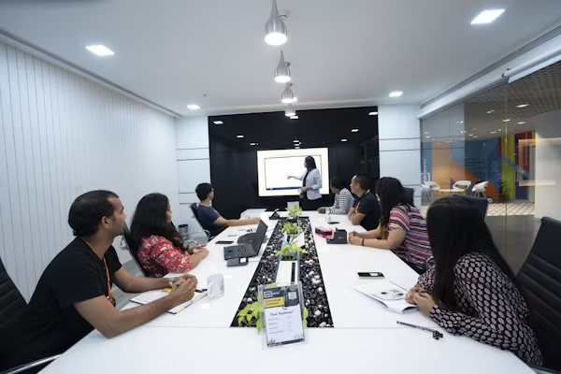
UHSussex Finance Apprentice scheme overview
Finance dept based at 3 main sites in Brighton, Worthing and Chichester
The department has a history of successful apprentices
6 Apprentices recruited from the local community through a competitive interview process
Mix of ages and experience recruited – none from a traditional finance background
One day interviews held with panel from Finance and Apprentice team
Apprentices joined different teams in Sept 23 for 18 months
Study for Level 3 AAT via Chichester College via Levy
4 days a week in the office, 1 day at college face to face
Each Apprentice assigned a buddy and course mentor

Slide 6
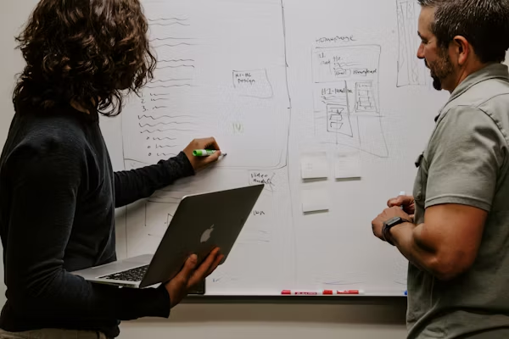
UHSussex Finance Apprentice scheme overview
College provides all coursework and teaching material – mix of face to face and online
College operate term time working – holidays require planning
Summer rotations to complete practical experience requirements
Regular meetings between managers and with college tutors to check work and academic progress
Excellent exam results and close working required of course material and teaching
Log book of practical experience required – managers sign off on knowledge, skills and behaviours in the Apprenticeship standards– Gateway process
End point assessment of competencies and interview

Slide 7

UHSussex Finance Apprentice - after the scheme
Preparation for life after the scheme
Apprentices provided with help writing applications and Interview practice
5 Apprentices successfully recruited to band 4 & band 5 roles
Most apprentices looking to continue AAT studies and CCAB qualifications
Final exit interview and formal sign off for Level 3
March 2025 all our Apprentices successfully completed their contracts

