Slide 1
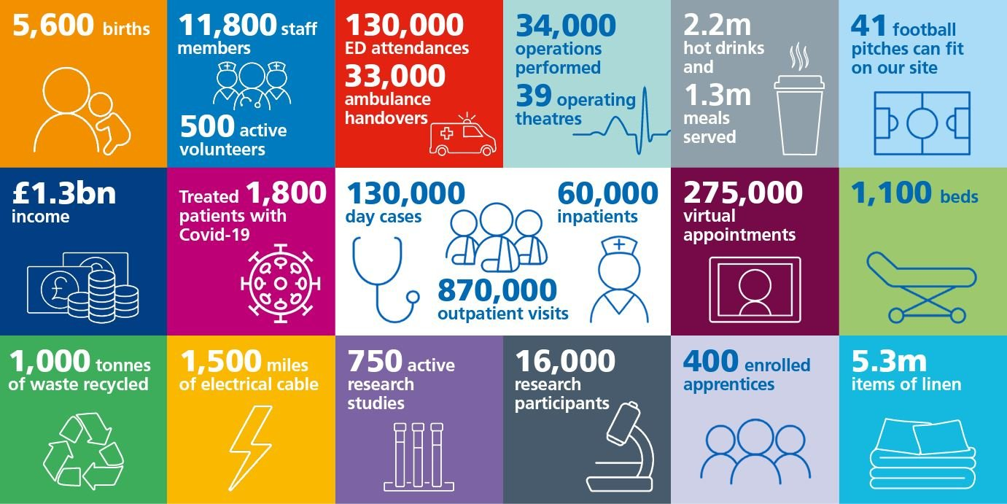
Overview of the Trust and our services :
Serve as both a local hospital (population 500,000) and a specialist hospital (population 6,000,000)
Teaching hospital (all healthcare roles)
https://www.cuh.nhs.uk/

Slide 2
Our Finance team supports all of the Trust services and is organized into the following functions :
Financial Management
Income
Commissioning
Financial Accounts
Payroll
Procurement
We are a large, diverse department, and are part of the wider NHS finance community. There are a range of roles in each function from junior (including apprentices) to senior, with secondment opportunities available.
Support is provided towards achieving professional accountancy qualifications. We are an accredited employer for ACCA, CIPFA and CIMA. Learning and development opportunities are provided for all staff.
https://careers.cuh.nhs.uk/

